Slide 1



NightFighers
Project of NightFighter’s Website

Slide 2
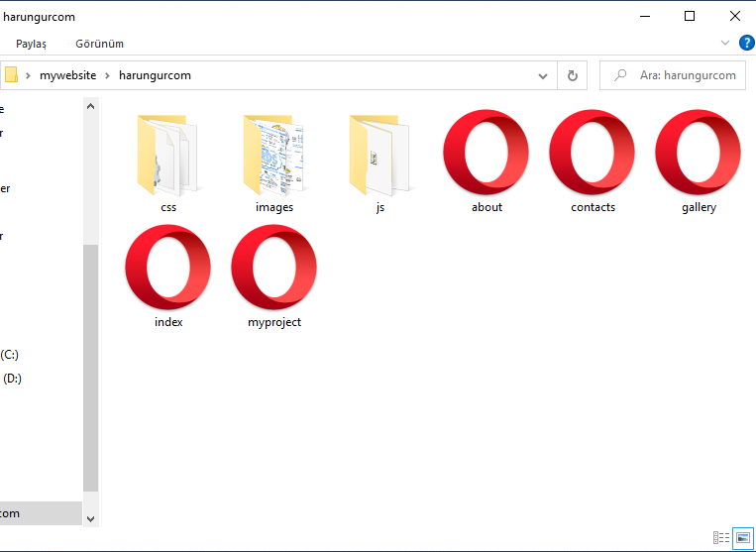
NightFighers
harungur.com HTML doc

Slide 3



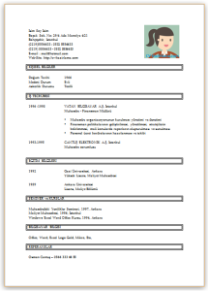
NightFighers
harungur.com
bradpitt.com
Brad Pitt
Personal Info
Brad Pitt

Slide 4


NightFighers
bradpitt.com
Brad Pitt

Slide 5
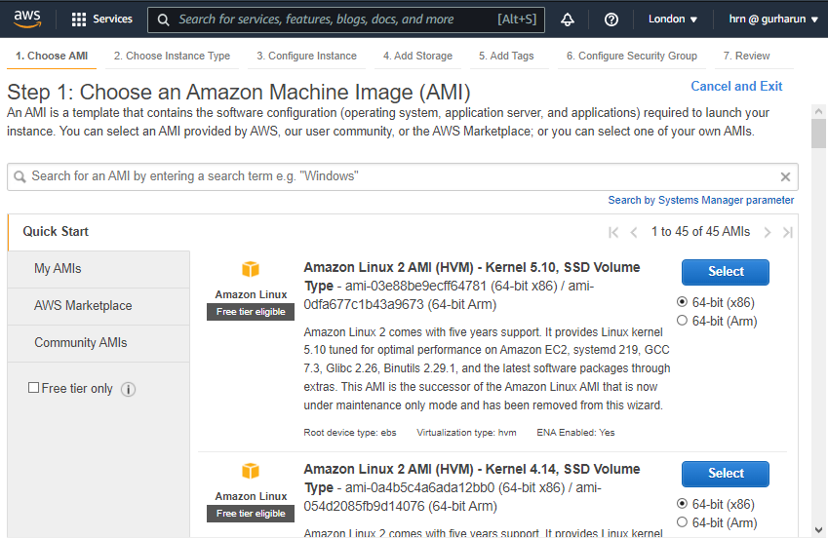
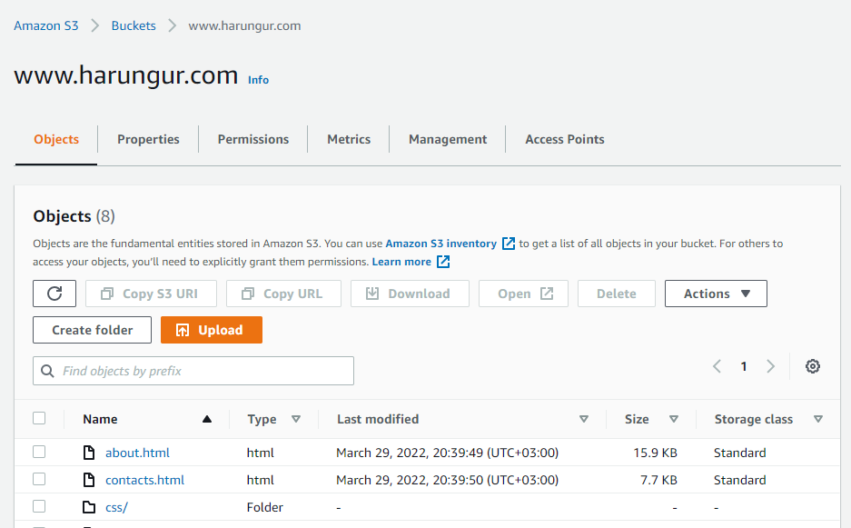
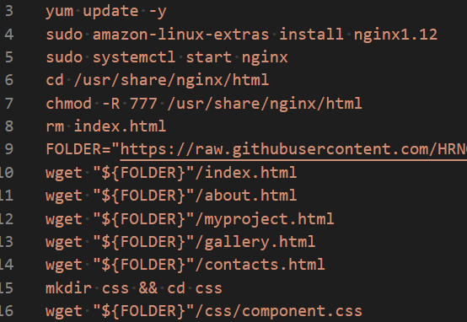
NightFighers
WebServer
Launch Ec2
Upload (wget)
Upload to S3
Set; Public and enable Static Webserver
Install Nginx

Slide 6




NightFighers
WebServer
EC2
S3

Slide 7
NightFighers
bradpitt.com
Brad Pitt
www.bradpitt.com

